Slide 1

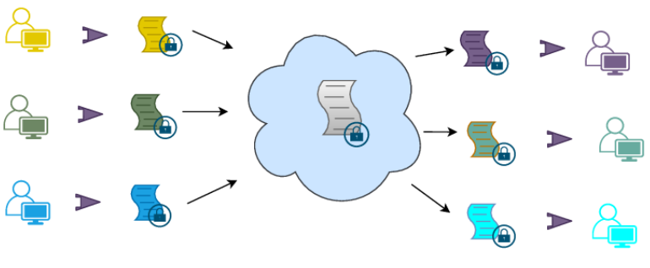
Homomorphic encryption on different federated learning schemes
Majdi Maalej
Master Seminar (Intro)
CISPA, Saarland University
06 Nov 2024

Slide 2

Agenda
Background
Motivation and Idea
Roadmap and Goal
Preliminary Results

Slide 3
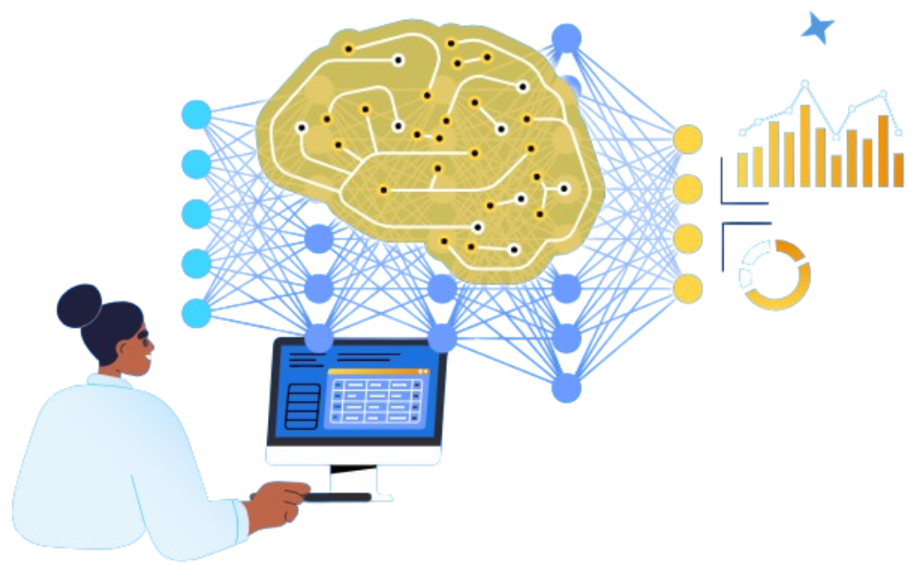
Machine Learning
allows machines to achieve human learning and reasoning capabilities.
quality of training data significantly impacts the effectiveness of AI services.
Problem: difficulties in gathering data due to sensitive private information that may be present in the data.
Background

Slide 4
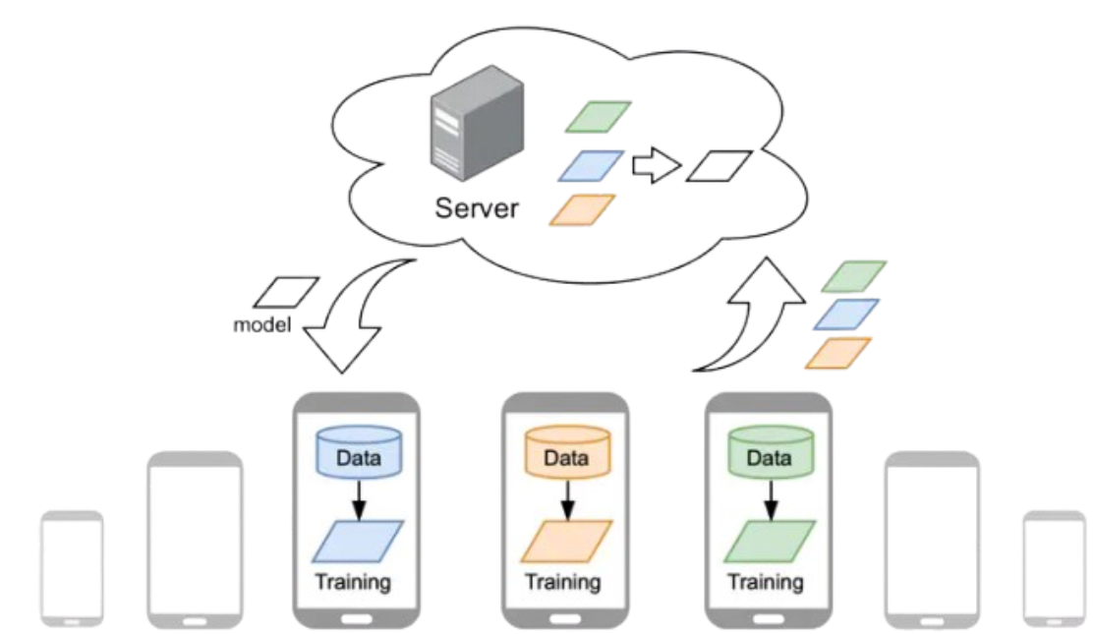
Federated Learning (FL)
updates the global model parameters
a machine learning setting where multiple entities (clients) collaborate in solving a machine learning problem, under the coordination of a central server.
prevents the leakage of sensitive private information because each client's raw data is stored locally and not exchanged or transferred.
focused updates intended for immediate aggregation are used to achieve the learning objective, until convergence is achieved.
Problem: server can be malicious and tries to reconstruct the original data from model updates received from clients, also known as model inversion attacks.
sends the updated global model parameters
return local model
parameters
training the model with local data
Background

Slide 5
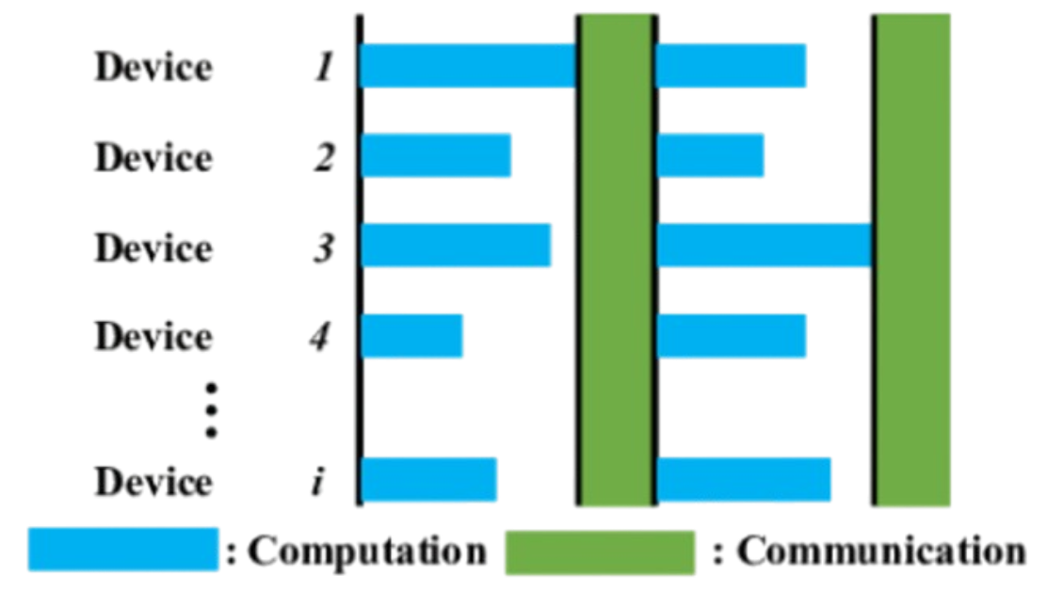
Synchronized Federated Learning
requires all participating clients to be done computation in order for the server to aggregate on each round.
In each round, the server transmits the latest update of the global model to all participating clients.
Problem: Because of the disparity of computing resources among different clients, synchronous algorithms suffer from degraded efficiency when waiting for straggler clients.
Background

Slide 6
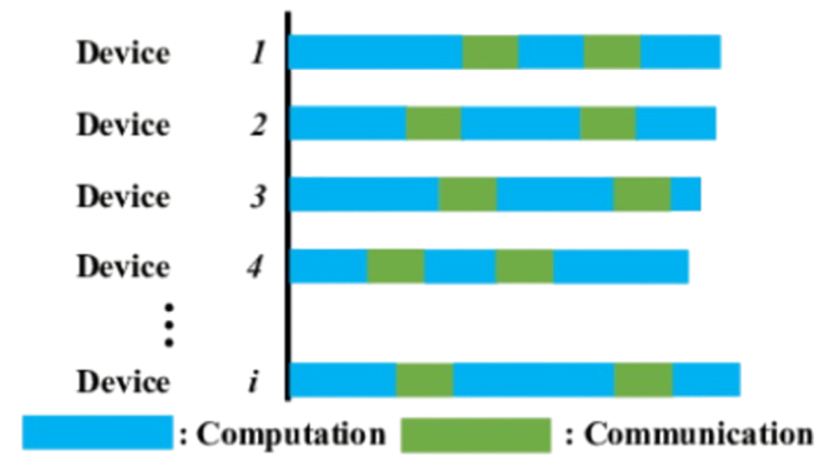
Asynchronized Federated Learning
does not require all participating clients for server aggregation on each round.
In each round, the server updates the global model with every newly received local model from a participating client, and then sends it back.
Problem: Asynchronous algorithms experience degradation in the convergence rate and final model accuracy on non-IID heterogeneous datasets due to stale local models and client drift.
Background

Slide 7
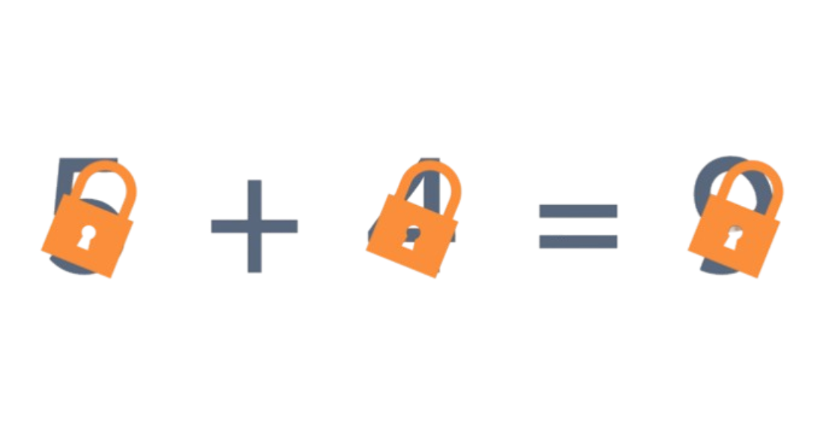
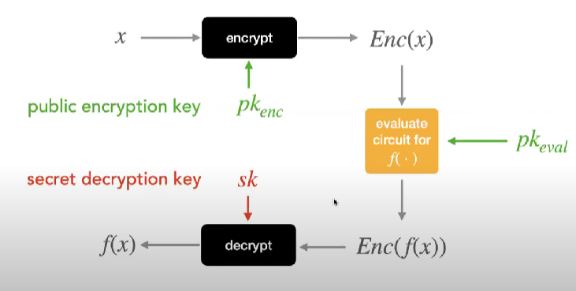
Homomorphic Encryption (HE)
a technology that enables arithmetic operations on ciphertexts without decryption.
neither the input nor the output will be visible to the server, and the evaluation can still happen on the encrypted input.
Partially Homomorphic Encryption (PHE): Allows only one operation (addition or multiplication) to be performed on encrypted data, repeatedly unlimited number of times.
Levelled/Somewhat Homomorphic Encryption (LHE/SHE): Supports both addition and multiplication but limits the number of operations.
Fully Homomorphic Encryption (FHE): Enables unlimited additions and multiplications on encrypted data, offering complete flexibility.
Types
Problem: adoption of homomorphic encryption in machine learning is slow, because API might be challenging to use for data scientists. Also, the cost for evaluation, both in terms of communication and computation.
Background

Slide 8
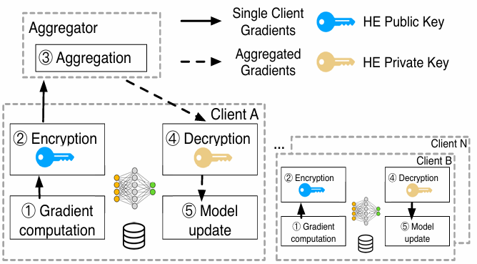
Combining HE with FL Algorithms
HE can effectively protect against model inversion attacks.
HE can secure FL environments against both external passive and active adversaries by keeping the data encrypted at all stages.
enables the centralized server to aggregate encrypted local model parameters without decryption => No Model Steal Attack
clients no longer have the concern of data leakage as the models sent to the server are encrypted => No Inference Attacks
Any model architecture is supported because training takes place in plaintext
Motivation and Idea

Slide 9
Related Work
Many works like IBM research:
let all the learning parties transmit encrypted gradients by homomorphic encryption
aggregate those gradients with a Partially Homomorphic Encryption (PHE) scheme called Paillier.
PHE allows arbitrary computation of only addition or multiplication (not together) on integers.
Cons:
Paillier imposes big overhead on the encryption and decryption and tends to be slow.
Here, FL on gradients, not on model parameters.
PHE lets us compute only on integers
Not very suitable for Machine Learning Applications
Motivation and Idea

Slide 10
Current Work
Looking into the challenges and benefits of using Homomorphic Encryption on different Federated Learning Schemes
HE used will support operations on approximate real numbers, called CKKS.
What is the additional overhead of CKKS on client-side and server-side? Is it significant?
What is the additional time that FL takes to converge in an encrypted setting compared to a plaintext setting?
Will LHE CKKS deteriorate accuracy of the global aggregated model? Or can it be a useful perturbation?
Not only regular synchronized mechanism will be explored, but also asynchronized scheme.
Which converges faster in an encrypted setting with heterogeneous data?
Which aggregation algorithm works best for both schemes in an encrypted setting?

Slide 11
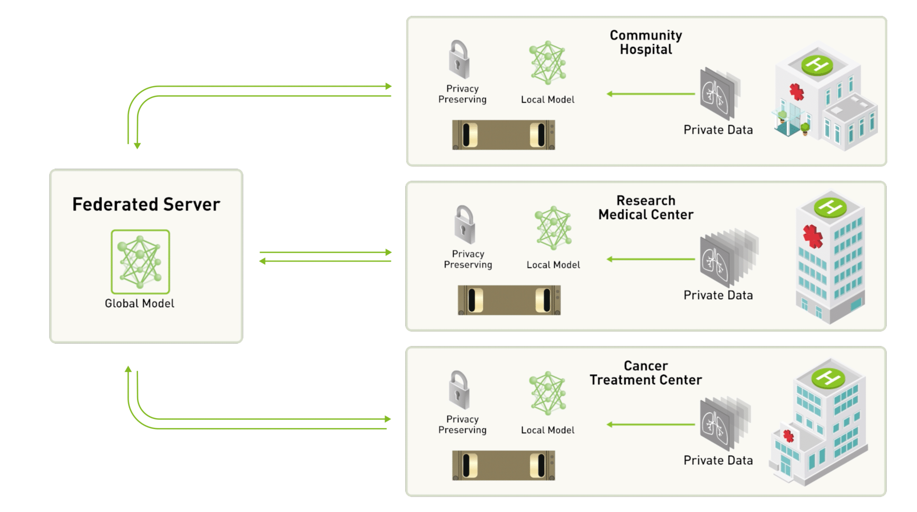
Real Life Use-Cases Example – Medical Field
Multiple independent training sessions
Each using its own dataset
Data ownership is maintained locally
Developing advanced models without sacrificing privacy or security
Comply with stringent privacy laws like GDPR or HIPAA
Fostering more effective partnerships across organizations.
Motivation and Idea

Slide 12
Threat Model and Assumptions
Threat Model:
Malicious Server
Eavesdropping Adversaries (Network-based)
Curious-but-Honest Clients
Assumptions:
Server has high computational resources
At least two clients participating
No collusion between server and clients
Clients hold data that is non-IID, reflecting real-world scenarios where data distribution varies across entities.
All clients need to share a common encryption context (e.g., CKKS parameters and public keys)
Motivation and Idea

Slide 13
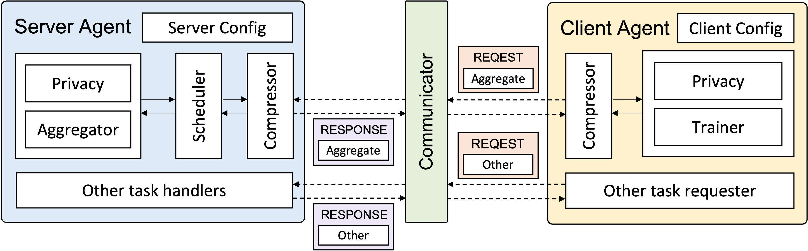
Tools Used
Federated Learning:
APPFL open-source framework
new, easy-to-use, clear documentation, customizable
Homomorphic Encryption:
TenSEAL library by Microsoft
works for large vectors/tensors,
most commonly used
CKKS Approximate Numbers Leveled Homomorphic Encryption Scheme
Datasets:
MNIST
Heterogeneous, Vertical, Non-IID
Aggregators:
Synchronized: FedAvg, etc.
Asynchronized: FedAsync, etc.
Semi-Asynchronized: FedCompass, etc.
Communication:
Message Parsing Interface (MPI)
used for simulating FL on a single machine
Model Training:
Convolutional Neural Network (CNN)
Motivation and Idea

Slide 14
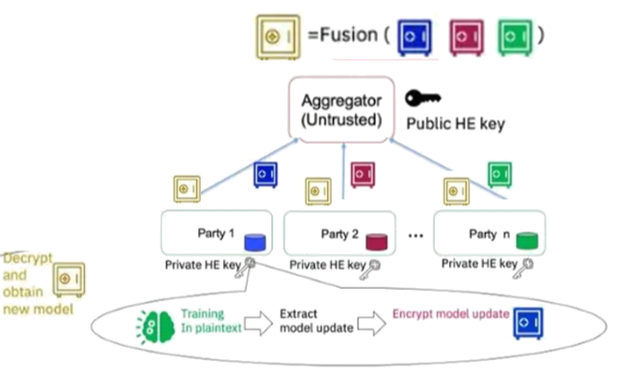
Methodology in Iterations
Each client performs local training on their data and updates his model parameters.
Each client encrypts their locally trained model parameters and sends it in a serialized manner to the server, along with the CKKS context (without secret key) as metadata.
Server deserializes the model parameters from every client using the CKKS context.
Server performs aggregation of the different encrypted model parameters homomorphically depending on the scheduler and aggregator used (i.e., FL scheme used).
Server serializes the newly globally aggregated model parameters and sends them back to clients.
Client deserializes and decrypts the received globally model parameters.
(either sync or async)
Roadmap and Goal

Slide 15
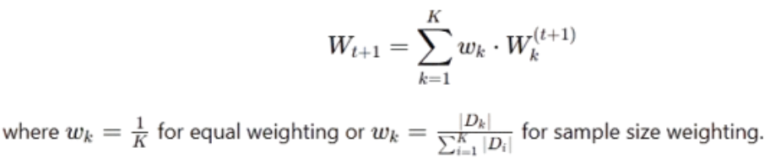
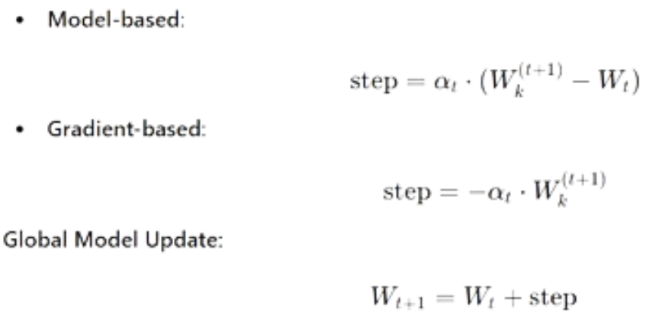
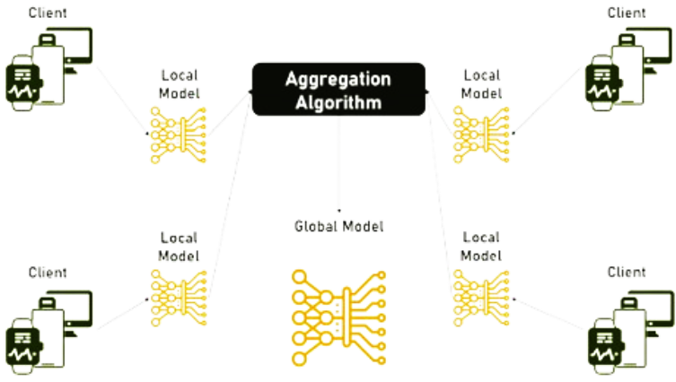
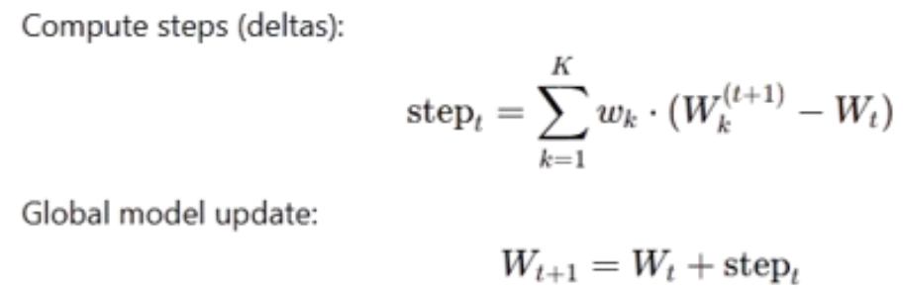
Aggregations
FedAvg
FedAsync
Step-based FedAvg
And many more…
Roadmap and Goal

Slide 16
Project Plan
Must-have criteria:
Integrate CKKS encryption into both synchronous and asynchronous FL schemes, enabling operations on encrypted model parameters.
Implement key management for shared encryption context (e.g., public and private keys) among clients.
Apply data partition for heterogeneity among clients using Dirichlet Sampling.
Measure computational and communication overheads of CKKS on client and server sides.
Compare performance (convergence and time) of encrypted setting with a plaintext (unencrypted) FL setting.
Compare performance (convergence) in both federated learning schemes (synchronized and asynchronized) on an encrypted setting
Evaluate base algorithms to other optimizations for aggregation
May-have criteria:
Compare performance (convergence) when using heterogeneous to homogeneous data partitioning
Evaluating the use of Semi-asynchronized scheme for federated learning that works with a server scheduler
Use of Differential Privacy on client data
Roadmap and Goal

Slide 17
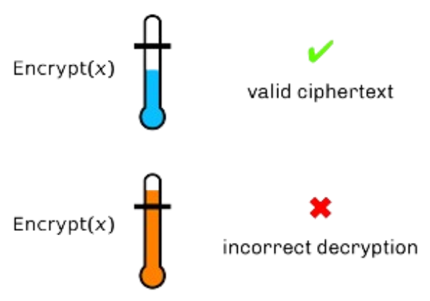
Noise created with Aggregation using CKKS
Situation:
Server keeps on updating the existing encrypted global model it holds.
After a certain number of FL iterations, server struggles to continue to aggregate.
Aggregation/Computation is done with CKKS context.
TenSEAL provides a leveled CKKS (not Fully Homomorphic).
Reason:
Noise grows with more multiplications in encrypted dimension.
Leveled HE allows only limited number of multiplications on an encrypted value.
LHE: As long as the noise is below a certain threshold, the ciphertext can be decrypted.
Possible Solution:
Since we assume clients are honest
After every epoch, the client not only send his new updated model encrypted, but also the received global model earlier from the server.
This way, the server does not have to operate on his existing saved encrypted global model.
Step-based FedAvg
Preliminary Results

Slide 18
References
[1] H. Fang and Q. Qian, “Privacy Preserving Machine Learning with Homomorphic Encryption and Federated Learning,” Future Internet, vol. 13, no. 4, p. 94, Apr. 2021, doi: 10.3390/fi13040094.
[2] M. Moshawrab, M. Adda, A. Bouzouane, H. Ibrahim, and A. Raad, “Reviewing Federated Learning Aggregation Algorithms; Strategies, Contributions, Limitations and Future Perspectives,” Electronics, vol. 12, no. 10, p. 2287, May 2023, doi: 10.3390/electronics12102287.
[3] M. Ryu, Y. Kim, K. Kim, and R. K. Madduri, “APPFL: Open-Source Software Framework for Privacy-Preserving Federated Learning,” 2022 IEEE International Parallel and Distributed Processing Symposium Workshops (IPDPSW), May 2022, doi: 10.1109/ipdpsw55747.2022.00175.
[4] Z. Li et al., ‘FedCompass: Efficient Cross-Silo Federated Learning on Heterogeneous Client Devices using a Computing Power Aware Scheduler’, arXiv [cs.LG]. 2024.
[5] A. Benaissa, B. Retiat, B. Cebere, and A. E. Belfedhal, ‘TenSEAL: A Library for Encrypted Tensor Operations Using Homomorphic Encryption’, arXiv [cs.CR]. 2021.
[6] “Federated Learning Meets Homomorphic Encryption,” IBM Research Blog, Feb. 09, 2021. https://research.ibm.com/blog/federated-learning-homomorphic-encryption
[7] H. B. McMahan, E. Moore, D. Ramage, S. Hampson, and B. A. y Arcas, ‘Communication-Efficient Learning of Deep Networks from Decentralized Data’, arXiv [cs.LG]. 2023.
[8] J. H. Cheon, A. Kim, M. Kim, and Y. Song, “Homomorphic Encryption for Arithmetic of Approximate Numbers,” Advances in Cryptology – ASIACRYPT 2017, pp. 409–437, 2017, doi: 10.1007/978-3-319-70694-8_15.
[9] C. Xie, S. Koyejo, and I. Gupta, ‘Asynchronous Federated Optimization’, arXiv [cs.DC]. 2020.
Bibliography

Slide 19
THANK YOU
Any Questions?

Slide 20
Initialization of Methodology
(executed at first and once)
Setup CKKS context for clients to use, and serialize it into a file
setting CKKS parameters
prepares key pairs
Setup server agent and communicator
loading custom server configurations
loading FL configurations for all clients to follow
Setup client agents and communicators
loading data
loading CKKS context that is shared on a file
Clients invoke the server
loading FL configurations
requesting initial global model (randomized by server)
sending sample size (if necessary)
Appendix

Slide 21
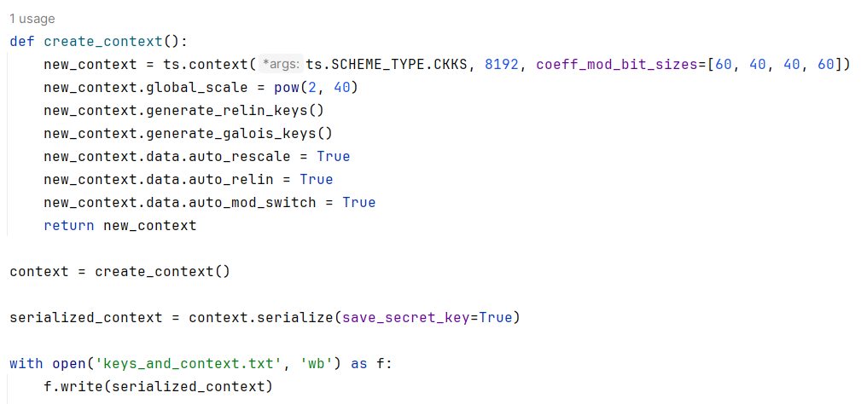
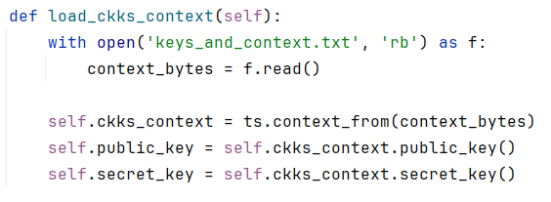
Key Management
Inside run_mpi.py
Part of client.py
Appendix

